Slide 1
Chapter 7: Deadlocks
April 2024

Slide 2
Chapter 7: Deadlocks
Deadlock Characterization
Methods for Handling Deadlocks
Deadlock Prevention
Deadlock Avoidance
Deadlock Detection
Recovery from Deadlock
Summary

Slide 3
Chapter Objectives
To develop a description of deadlocks, which prevent sets of concurrent processes from completing their tasks
To present a number of different methods for preventing or avoiding deadlocks in a computer system

Slide 4
System Model
System consists of resources
Resource types R₁, R₂, . . ., R_{m}
CPU cycles, memory space, I/O devices
Mutex lock, semaphore
messages
Each resource type R_{i} has W_{i} instances.
Each process utilizes（使用） a resource as follows:
request （wait）
use
release
open()-close(), wait()-signal(), allocate()-free()

Slide 5
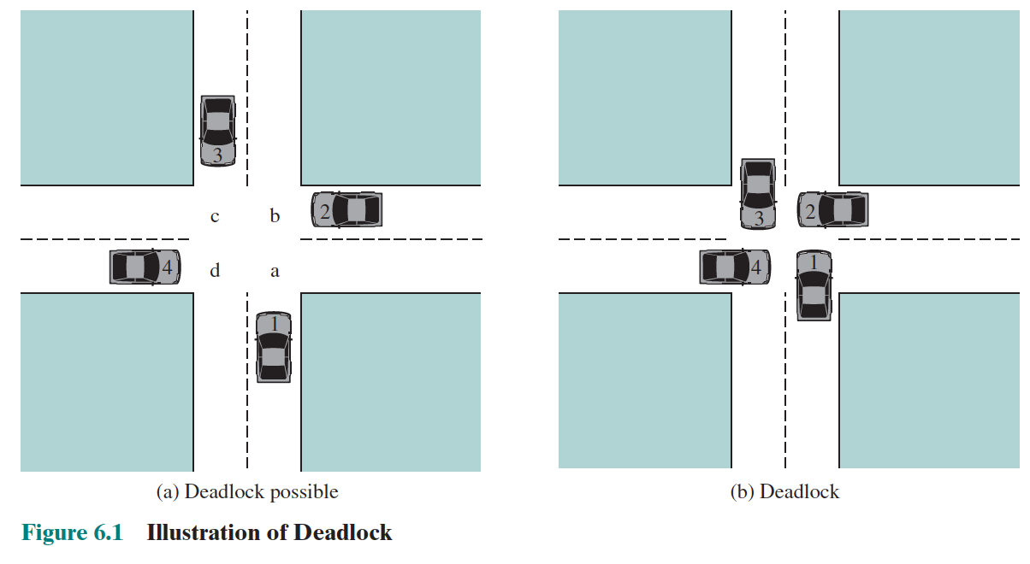
What is deadlock

Slide 6
What is deadlock
A set of processes is deadlocked when each process in the set is blocked awaiting an event (typically the freeing up of some requested resource) that can only be triggered by another blocked process in the set
Deadlock is permanent（永久的） because none of the events is ever triggered

Slide 7
Deadlock Example
/* thread one runs in this function */
void *do work one(void *param) {
pthread mutex lock(&first mutex);
pthread mutex lock(&second mutex);
/** * Do some work */ pthread mutex unlock(&second mutex);
pthread mutex unlock(&first mutex);
pthread exit(0);
}
/* thread two runs in this function */
void *do work two(void *param) {
pthread mutex lock(&second mutex);
pthread mutex lock(&first mutex);
/** * Do some work */ pthread mutex unlock(&first mutex);
pthread mutex unlock(&second mutex);
pthread exit(0);
}
此时thread1想获取second mutex，thread2想获取first mutex，
死锁
Demo:
ABBA
Notes:
两个线程都执行完第一行，还没有执行第二行
那么此时thread1想获取second mutex，thread2想获取first mutex，死锁

Slide 8
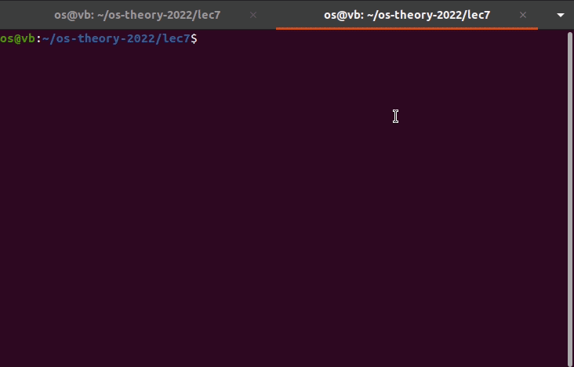
Two Dining Philosophers

Slide 9
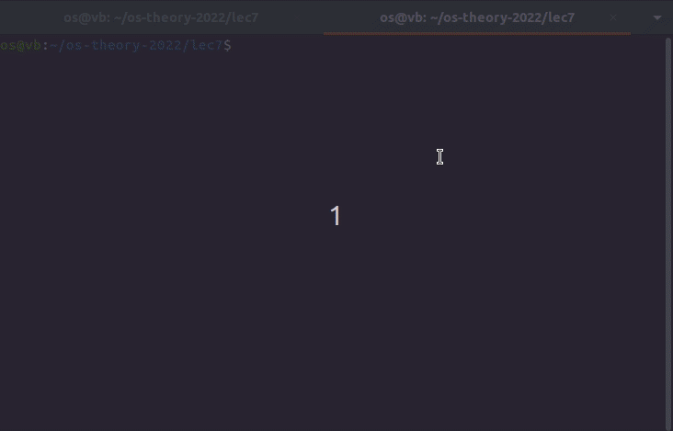
Two Dining Philosophers

Slide 10
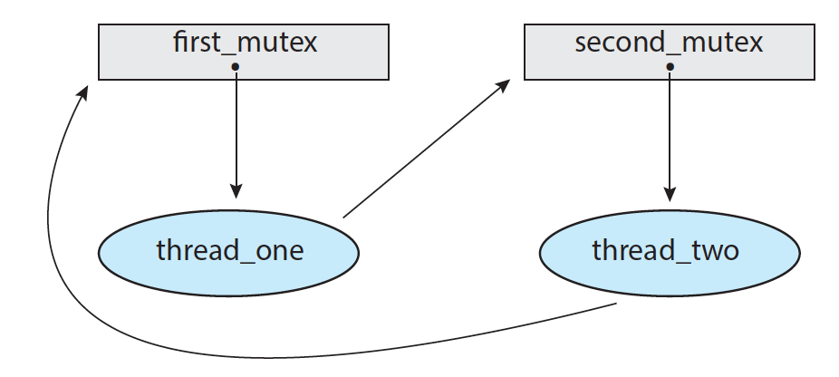
ABBA

Slide 11
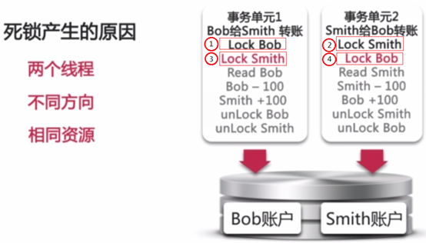
Example

Slide 12
Deadlock Characterization

Slide 13
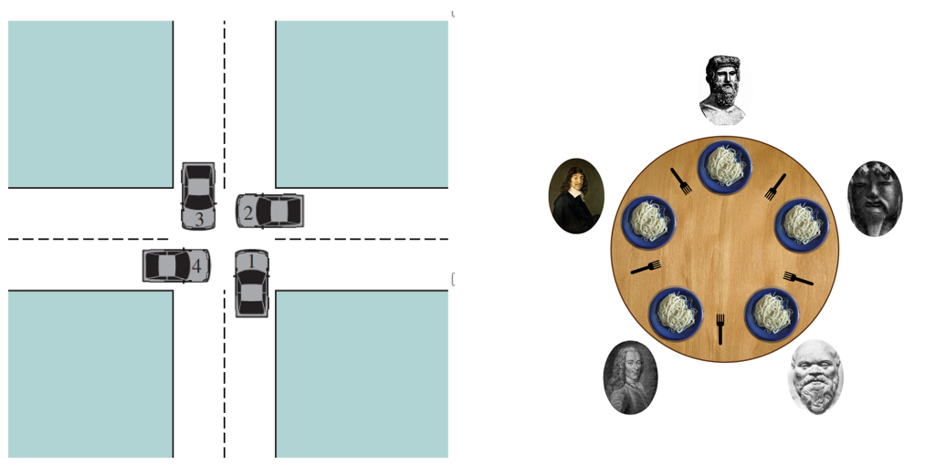
Necessary Conditions for Deadlock
Mutual exclusion（互斥）: only one process at a time can use a resource（资源非共享）
Hold and wait（占有并等待）: a process holding at least one resource is waiting to acquire additional resources held by other processes（占有资源并等待被其他进程占有的资源）
No preemption（非抢占）: a resource can be released only voluntarily by the process holding it, after that process has completed its task
Circular wait（循环等待）: there exists a set {P₀, P₁, …, P_{n}} of waiting processes such that P₀ is waiting for a resource that is held by P₁, P₁ is waiting for a resource that is held by
P₂, …, P_{n–1} is waiting for a resource that is held by P_{n}, and P_{n} is waiting for a resource that is held by P₀.
Cars, philosophers

Slide 14
Resource-Allocation Graph
A set of vertices V and a set of edges E.
V is partitioned into two types:
P = {P₁, P₂, …, P_{n}}, the set consisting of all the processes in the system
R = {R₁, R₂, …, R_{m}}, the set consisting of all resource types in the system
request edge – directed edge P_{i} → R_{j}
assignment edge – directed edge R_{j} → P_{i}

Slide 15
Resource-Allocation Graph (Cont.)
Process
Resource Type with 4 instances
P_{i} requests instance of R_{j}
P_{i} is holding an instance of R_{j}
P_{i}
R_{j}
P_{i}
R_{j}

Slide 16
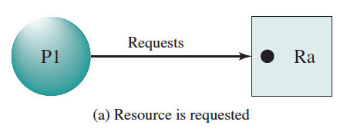
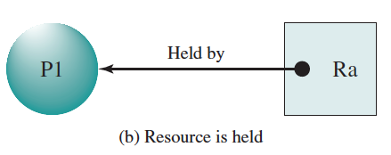
Request and Hold

Slide 17
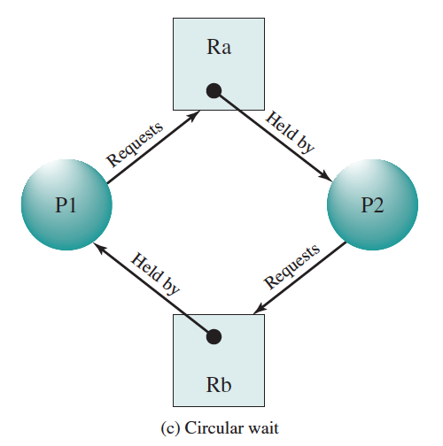
Deadlock

Slide 18
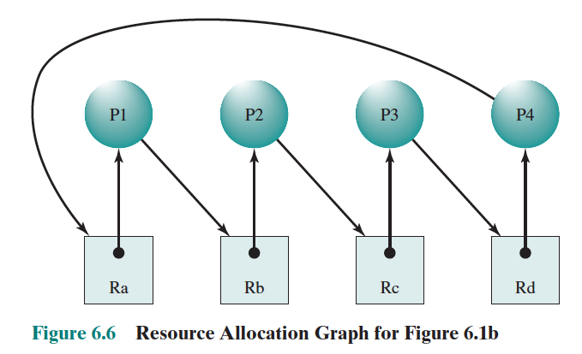
Deadlock

Slide 19
Question: Deadlocked Process P1？
R1
P1
P1总是要释放R1，届时就可以再次占有。
不满足hold and wait条件，并不是wait其他进程占有的资源
Notes:
P1总是要释放R1，届时就可以再次占有。
不满足hold and wait条件，并不是wait其他进程占有的资源

Slide 20
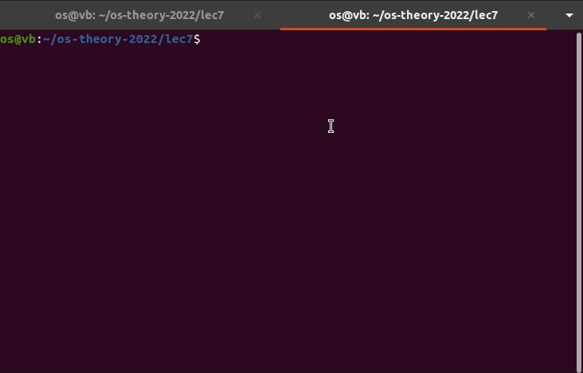
Demo

Slide 21
Question: Deadlocked Process P3？
P3
R1
P2
P1
R2
P3: P3等待不持有，P3未参与循环等待
Notes:
P3: P3等待不持有，P3未参与循环等待

Slide 22
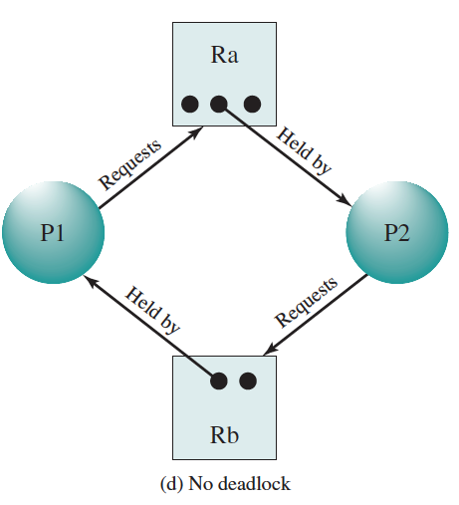
Graph with A Cycle: Sufficient?
Notes:
No, because free resource available

Slide 23
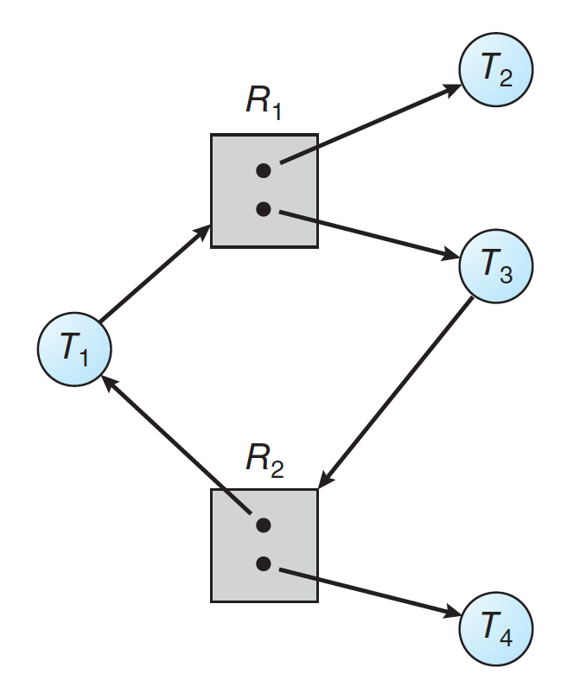
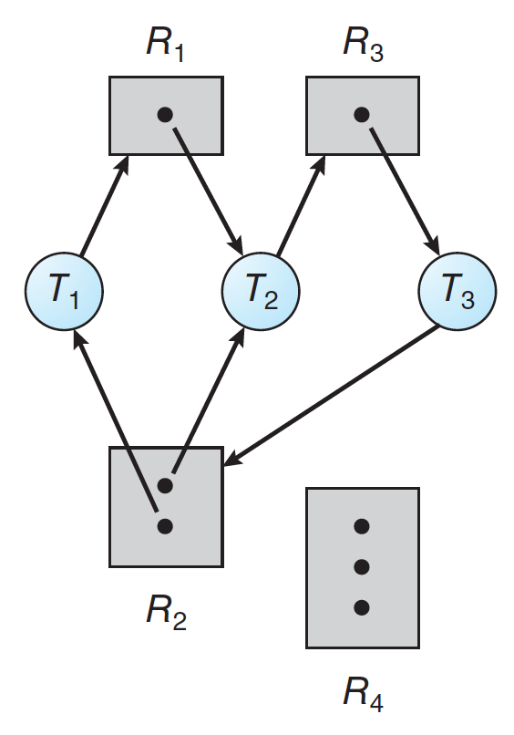
Exercise: Graph With A Cycle
Notes:
Left: no (T2、T4持有不等待，循环等待也视为不存在，T1视为等待T2，不构成循环)
Right: yes；T3等待T1或者T2，这种情况比较复杂；3个进程都是持有等待，循环在哪里？

Slide 24
Summary
If graph contains no cycles ⇒ no deadlock
If graph contains a cycle ⇒
if only one instance per resource type, then deadlock（每种资源只有一个，一定）
if several instances per resource type, possibility of deadlock（每种资源有多个，可能）

Slide 25
Methods for Handling Deadlocks
Ensure that the system will never enter a deadlock state
Prevention
Avoidance
Allow the system to enter a deadlock state and then recover
Detection
Recovery
Ignore the problem and pretend that deadlocks never occur in the system; used by most operating systems

Slide 26
Deadlock Prevention

Slide 27
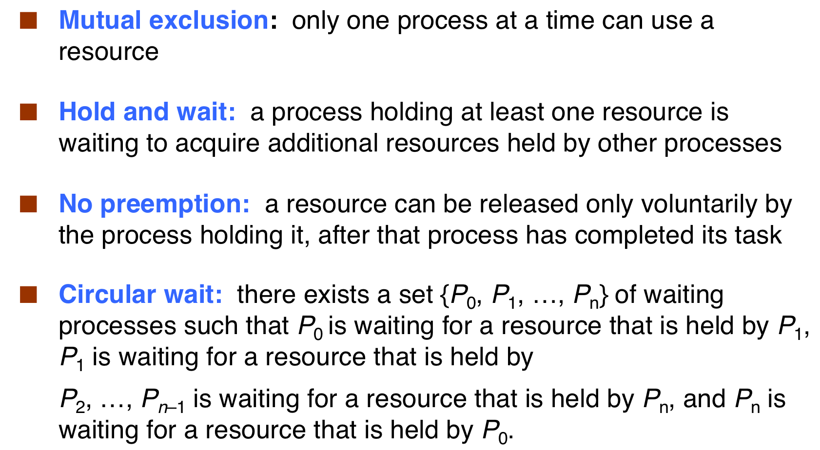
Break Necessary Conditions
Notes:
死锁的预防
只要破坏了四个必要条件中的任意一个条件, 死锁就不会发生了.
1.打破互斥条件
就是允许进程同时访问某些资源. 但是, 有的资源不允许被同时访问, 这是由资源本身的属性决定的. 所以, 这种办法并无使用价值
2.打破禁止抢占
就是允许进程强行从占有者那里夺取资源. 当一个进程已占有了某些资源, 有申请新的资源, 但不能立即被满足时, 必须释放所占有的全部资源, 以后再重新申请. 这种预防思索的方法实现起来困难, 会降低系统性能.
3.打破持有和等待状态
可以实行资源预先分配策略. 即进程在运行前一次性地向系统申请它所需要的全部资源. 如果某个进程所需的全部资源得不到满足, 则不分配任何资源, 此进程暂不运行. 只有当系统能够满足当前进程的全部资源需求时, 才一次性地将所申请的资源全部分配给该进程. 由于运行的进程已占有了它所需的全部资源, 所以不会发生占有资源又申请资源的现象, 因此不会发生死锁. 但是, 这种策略有如下缺点:
a) 许多情况下, 一个进程在执行之前并不可能知道它所需要的全部资源. 这是由于进程执行时是动态的, 不可预测的.
b)资源利用率低. 无论所分资源何时用到, 一个进程要占有全部资源后才能执行. 即使有些资源最后才被该进程用到一次, 但该进程在生存期一直占有它, 造成长期占着不用的状况. 显然是一种极大的资源浪费.
c)降低了进程的并发性. 因为资源有限, 又加上存在浪费, 能分配到需要的全部资源的进程个数必然少了
4.打破循环等待
实行资源有序分配策略. 即将资源事先编号, 按号分配, 进程对资源的请求必须按资源序号递增的舒徐提出. 这样就不会产生环路, 从而预防了死锁. 这种策略与前面的策略相比, 资源的利用率和系统吞吐量都有很大提高, 但是也存在以下缺点:
限制了进程对资源的请求, 同时给系统中所有资源编号也是件困难事, 增加了系统开销.
为了遵循按编号申请的次序, 暂不使用的资源也需要提前申请, 增加了进程对资源的占用时间.
Java中死锁的避免
1.加锁顺序
当多个线程需要相同的一些锁, 但是按照不同的顺序加锁, 死锁就很容易发生.
如果能确保所有的县城都是按照相同的顺序获得锁, 那么死锁就不会发生了.
2.加锁时限
可以避免死锁的方法是在尝试获取锁的时候加一个超时时间, 线程可以在获取锁超时以后主动释放之前已经获得的所有的锁. 通过这种方式, 也可以很有效的避免死锁
使用Lock接口的 tryLock(long, TimeUnit) 方法, 当获取锁超时时主动释放之前已经获得的所有锁

Slide 28
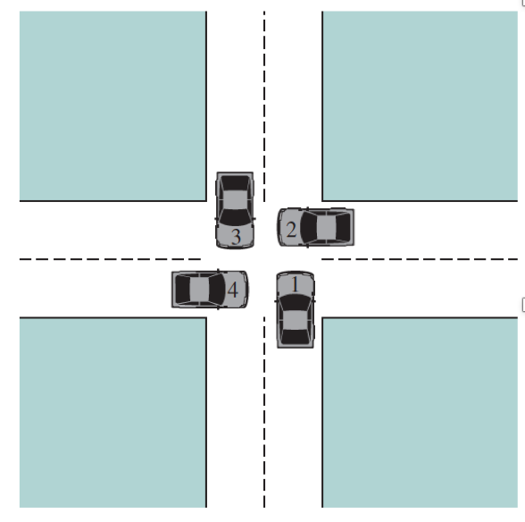
Deadlock Prevention
Mutual Exclusion（不可更改）
Non-Preemption（不可更改）

Slide 29
Deadlock Prevention
Hold and Wait – must guarantee that whenever a process requests a resource, it does not hold any other resources（进程只能在不占有任何资源的情况下申请资源）
Require process to request and be allocated all its resources before it begins execution
E.g.： tryLock(), tryLock(long time, TimeUnit unit)
Notes:
汽车启动前保证前面车道不会有车。
红绿灯：一次两个位置，消除持有等待；红绿灯交替，保证公平性

Slide 30
Deadlock Prevention (Cont.)
Circular Wait – impose（施加） a total ordering of all resource types, and require that each process requests resources in an increasing order of enumeration
proof
ABBA -> ABAB
F(A)=1;F(B)=2
Thread1占有A请求B，thread2占有B无法请求A
Notes:
4.打破循环等待
实行资源有序分配策略. 即将资源事先编号, 按号分配, 进程对资源的请求必须按资源序号递增的舒徐提出. 这样就不会产生环路, 从而预防了死锁. 这种策略与前面的策略相比, 资源的利用率和系统吞吐量都有很大提高, 但是也存在以下缺点:
限制了进程对资源的请求, 同时给系统中所有资源编号也是件困难事, 增加了系统开销.
为了遵循按编号申请的次序, 暂不使用的资源也需要提前申请, 增加了进程对资源的占用时间.
F(A)=1;F(B)=2
Thread1占有A请求B，thread2占有B无法请求A

Slide 31
Deadlock Avoidance

Slide 32
Deadlock Avoidance: Banker’s Algorithm
Banker’s algorithm is named so because it is used in banking system to check whether loan can be sanctioned to a person or not.
Suppose there are n number of account holders in a bank and the total sum of their money is S. If a person applies for a loan then the bank first subtracts the loan amount from the total money that bank has and if the remaining amount is greater than S then only the loan is sanctioned. It is done because if all the account holders comes to withdraw their money then the bank can easily do it.
In other words, the bank would never allocate its money in such a way that it can no longer satisfy the needs of all its customers. The bank would try to be in safe state always.

Slide 33
Deadlock Detection and Recovery

Slide 34
Deadlock Detection
Single instance
Resource allocation graph → wait-for graph
Cycle
Mutex lock！

Slide 35
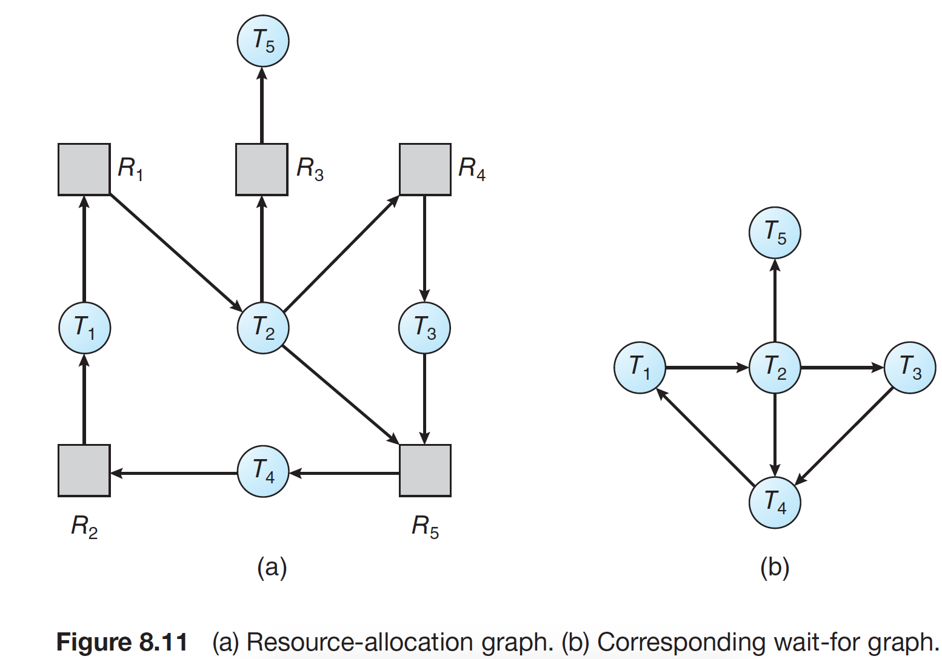
Wait-for Graph
Notes:
省略掉进程中间的资源，直接在进程之间建立等待关系

Slide 36
Wait-for Graph： A Cycle？
Topological sorting
Notes:
如果形成环路，则一定是死锁

Slide 37
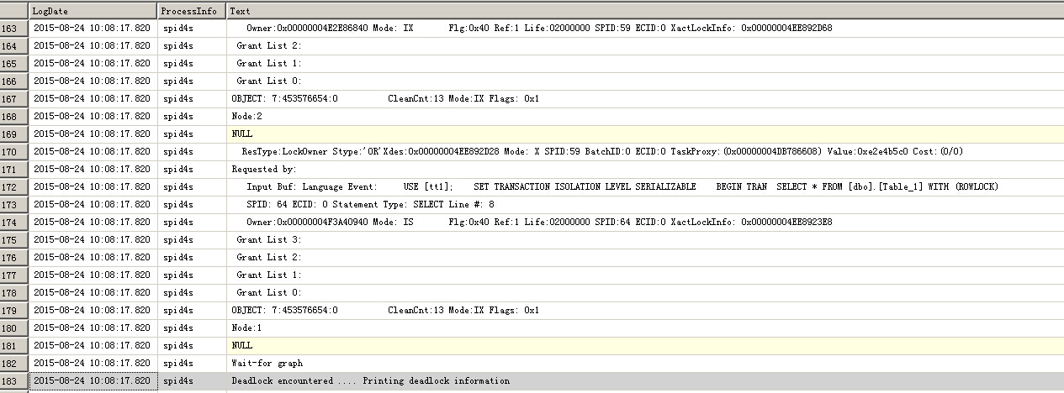
Database Application
Notes:
https://www.cnblogs.com/MYSQLZOUQI/p/4756158.html
Microsoft SQL Server
innodb引擎

Slide 38
Detection Algorithm Usage
How often is a deadlock likely to occur?
How many threads will be affected by deadlock when it happens?
When a process request resources
E.g. 锁请求无法满足时
Low CPU utilization

Slide 39
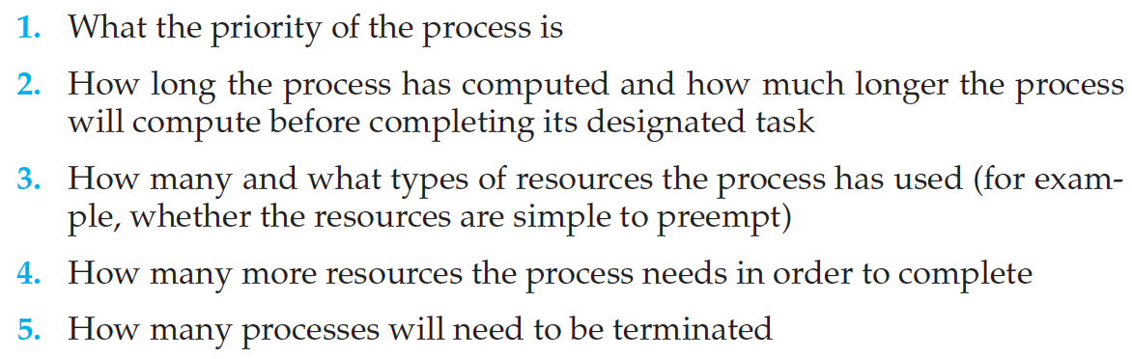
Recovery: Process Termination
Abort all deadlocked processes（代价很大）
Abort one process at a time until the deadlock cycle is eliminated（每abort一个进程都要使用detection algorithm）
In which order should we choose to abort?（min cost）

Slide 40
Exercise： Detection and Recovery
看终止这个进程还会不会形成cycle
Notes:
Abort 哪个进程能够recovery？
T5: not
T3: not，124还是cycle
T4: not; 设想t4释放资源，该资源被t2获取，则t2和t3形成环路
T1: not; 设想t1释放资源，被t4获取，t4完成后释放资源，然后形成和上述类似的局面
T2: yes，没有cycle产生

Slide 41
Recovery: Rollback
Selecting a victim（受害者） – minimize cost
MySQL attempts to select transactions that minimize the number of rows being inserted, updated, or deleted
Rollback – return to some safe state, restart process for that state
checkpoint

Slide 42

Ignore
Ostrich
Frequency of deadlock

Slide 43
Summary
Deadlock
Necessary conditions
Deadlock prevention and avoidance
Deadlock detection and recovery

Slide 44
A Brief Review of Process Management
Interrupt/system call
User/kernel mode
Process/threads
PCB (pid, state, PC)
Context, context switch
Thread models
Scheduling
Scheduling occasion
Criteria
Policy
Synchronization
Race condition/critical section
Mutex lock/semaphore
Deadlock

Slide 45
The End

Slide 46
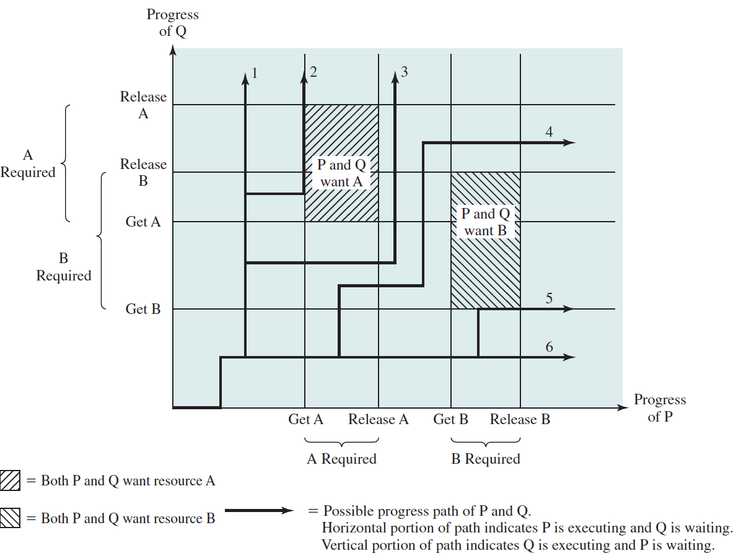
Joint Progress Diagram: Single CPU
Notes:
Single processor

Slide 47
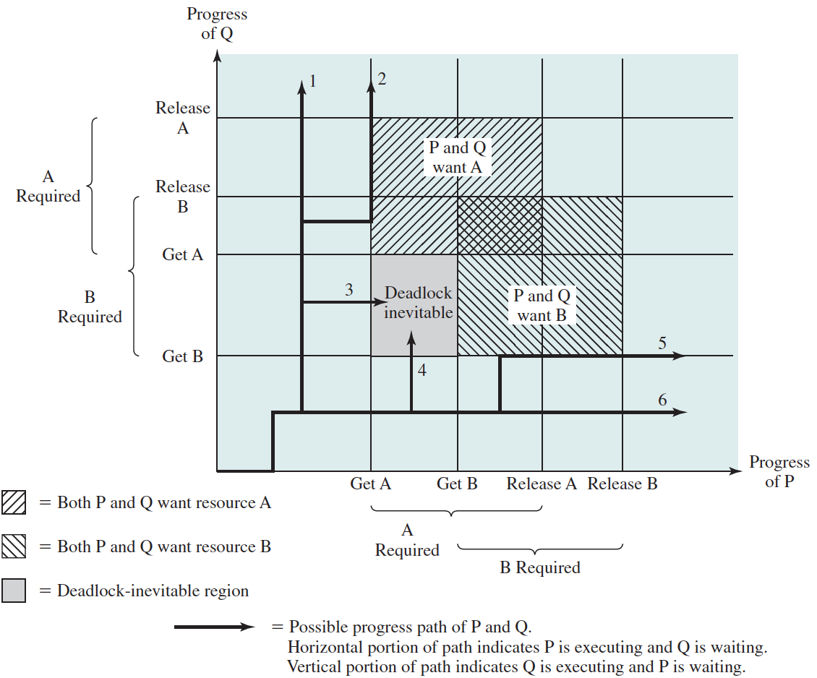
Joint Progress Diagram: Single CPU

